Slide 1
Programming Language II CSE-215
Prof. Dr. Mohammad Abu Yousuf
yousuf@juniv.edu

Slide 2
Overview of Java

Slide 3
What is java?
Developed by Sun Microsystems (James Gosling)
A general-purpose object-oriented language
Based on C/C++
Designed for easy Web/Internet applications
Widespread acceptance

Slide 4
Java Features (1)
Simple
fixes some clumsy features of C++
no pointers
automatic garbage collection
rich pre-defined class library http://java.sun.com/j2se/1.4.2/docs/api/
Object oriented
focus on the data (objects) and methods manipulating the data
all functions are associated with objects
almost all datatypes are objects (files, strings, etc.)
potentially better code organization and reuse

Slide 5
Java Features (2)
Interpreted
java compiler generate byte-codes, not native machine code
the compiled byte-codes are platform-independent
java bytecodes are translated on the fly to machine readable instructions in runtime (Java Virtual Machine)
Portable
same application runs on all platforms
the sizes of the primitive data types are always the same
the libraries define portable interfaces

Slide 6
Java Features (3)
Reliable
extensive compile-time and runtime error checking
no pointers but real arrays. Memory corruptions or unauthorized memory accesses are impossible
automatic garbage collection tracks objects usage over time
Secure
usage in networked environments requires more security
memory allocation model is a major defense
access restrictions are forced (private, public)

Slide 7
Java Features (4)
Multithreaded
multiple concurrent threads of executions can run simultaneously
utilizes a sophisticated set of synchronization primitives (based on monitors and condition variables paradigm) to achieve this
Dynamic
java is designed to adapt to evolving environment
libraries can freely add new methods and instance variables without any effect on their clients
interfaces promote flexibility and reusability in code by specifying a set of methods an object can perform, but leaves open how these methods should be implemented
can check the class type in runtime

Slide 8
Java Disadvantages
Slower than compiled language such as C
an experiment in 1999 showed that Java was 3 or 4 times slower than C or C++
title of the article: “Comparing Java vs. C/C++ Efficiency Issues to Interpersonal Issues” (Lutz Prechelt)
adequate for all but the most time-intensive programs

Slide 9
Introduction
Java is an object-oriented programming language. Everything in Java is an object. Object-oriented means we organize our software as a combination of different types of objects that incorporates both data and behavior.
Java includes the three pillars of object-oriented development:
Encapsulation
Inheritance
Polymorphism

Slide 10
Encapsulation
Encapsulation is the mechanism that binds together code and the data it manipulates, and keeps both safe from outside interference and misuse.
In an object-oriented language, code and data may be combined in such a way that a self-contained "black box" is created.
When code and data are linked together in this fashion, an object is created. In other words, an object is the device that supports encapsulation.
In OOP paradigm, "object" refers to a particular instance of a class.

Slide 11
Encapsulation
Within an object, code, data, or both may be private to that object or public.
Private code or data is known to and accessible only by another part of the object.
When code or data is public, other parts of your program may access it even though it is defined within an object.

Slide 12
Polymorphism
Polymorphism means to process objects differently based on their data type.
In other words it means, one method with multiple implementation, for a certain class of action. And which implementation to be used is decided at runtime depending upon the situation (i.e., data type of the object).
A real-world example of polymorphism is a thermostat. No matter what type of furnace your house has (gas, oil, electric, etc.), the thermostat works the same way. In this case, the thermostat (which is the interface) is the same no matter what type of furnace (method) you have.

Slide 13
Inheritance
Inheritance is the process by which one object can acquire the properties of another object.
It supports the concept of hierarchical classification.
For example, a Red Delicious apple is part of the classification apple, which in turn is part of the fruit class, which is under the larger class food.
Without the use of classifications, each object would have to define explicitly all of its characteristics.

Slide 14
This is a simple java program
Call this file “Example. Java”
class Example{
public static void main(String args[]){
System.out.println("Hello Java");
}
}

Slide 15
For most computer languages, the name of the file that holds the source code to a program is immaterial. However, this is not the case with Java.
The first thing that you must learn about Java is that the name you give to a source file is very important.
For this example, the name of the source file should be Example.java.
In Java, a source file is officially called a compilation unit.
The Java compiler requires that a source file use the .java filename extension.

Slide 16
Here, the name of the class defined by the program is also Example.
This is not a coincidence. In Java, all code must reside inside a class. By convention, the name of the main class should match the name of the file that holds the program.
You should also make sure that the capitalization of the filename matches the class name. The reason for this is that Java is case-sensitive.

Slide 17
Explanation:
This line begins the main( ) method.
All Java applications begin execution by calling main( ).
The public keyword is an access modifier, which allows the programmer to control the visibility of class members. When a class member is preceded by public, then that member may be accessed by code outside the class in which it is declared.
In this case, main( ) must be declared as public, since it must be called by code outside of its class when the program is started.
public static void main(String args[])

Slide 18
static is a keyword. If we declare any method as static, it is known as the static method. The core advantage of the static method is that there is no need to create an object to invoke the static method. The main method is executed by the JVM, so it doesn't require to create an object to invoke the main method. So it saves memory.
The keyword void simply tells the compiler that main() does not return a value.
The main() is the method called when a Java application begins.

Slide 19
Any information that you need to pass to a method is received by variables specified within the set of parentheses that follow the name of the method. These variables are called parameters.
In main( ), there is only one parameter, a complicated one.
String args[ ] declares a parameter named args, which is an array of instances of the class String.
Arrays are collections of similar objects. Objects of type String store character strings. In this case, args receives any command-line arguments present when the program is executed.

Slide 20
One other point: main( ) is simply a starting place for your program. A complex program will have dozens of classes, only one of which will need to have a main( ) method to get things started.

Slide 21
This line outputs the string “This is a simple Java program.” followed by a new line on the screen. Output is actually accomplished by the built-in println() method. In this case, println( ) displays the string which is passed to it.
The line begins with System.out.
System is a predefined class that provides access to the system, and out is the output stream that is connected to the console.
System.out.println("Hello Java");

Slide 22
Basic Syntax
About Java programs, it is very important to keep in mind the following points.
Case Sensitivity - Java is case sensitive, which means identifier Hello and hello would have different meaning in Java.
Class Names - For all class names the first letter should be in Upper Case. If several words are used to form a name of the class, each inner word's first letter should be in Upper Case. Example: class MyFirstJavaClass
Method Names - All method names should start with a Lower Case letter. If several words are used to form the name of the method, then each inner word's first letter should be in Upper Case. Example: public void myMethodName()

Slide 23
Program File Name - Name of the program file should exactly match the class name. When saving the file, you should save it using the class name (Remember Java is case sensitive) and append '.java' to the end of the name (if the file name and the class name do not match your program will not compile). Example: Assume 'MyFirstJavaProgram' is the class name. Then the file should be saved as'MyFirstJavaProgram.java'
public static void main(String args[]) - Java program processing starts from the main() method which is a mandatory part of every Java program.

Slide 24
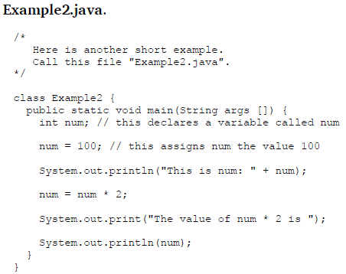
This is num: 100
The value of num * 2 is 200

Slide 25
Explanation:
Using the + operator, you can join together as many items as you want within a single println( ) statement.

Slide 26
Java Identifiers
All Java components require names. Names used for classes, variables and methods are called identifiers.
In Java, there are several points to remember about identifiers. They are as follows:
All identifiers should begin with a letter (A to Z or a to z), currency character ($) or an underscore (_).
After the first character identifiers can have any combination of characters.

Slide 27
A key word cannot be used as an identifier.
Most importantly identifiers are case sensitive.
Examples of legal identifiers: age, $salary, _value, __1_value
Examples of illegal identifiers: 123abc, -salary

Slide 28
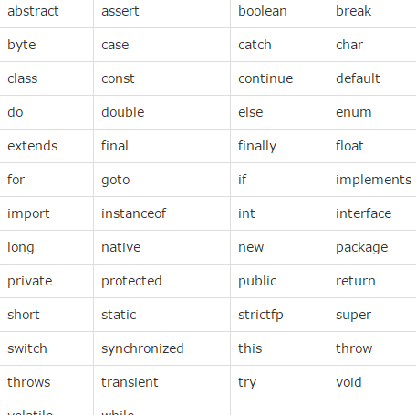
Java Keywords

Slide 29
Java Variables
A variable is a container which holds the value while the java program is executed. A variable is assigned with a data type.
Variable is a name of memory location.
There are three types of variables in java:
local,
instance and
static.

Slide 30
Java Variables
1) Local Variable
A variable declared inside the body of the method is called local variable. You can use this variable only within that method and the other methods in the class aren't even aware that the variable exists.
A local variable cannot be defined with "static" keyword.
2) Instance Variable
A variable declared inside the class but outside the body of the method, is called instance variable. It is not declared as static.
It is called instance variable because its value is instance specific and is not shared among instances.
3) Static variable
A variable which is declared as static is called static variable. It cannot be local. You can create a single copy of static variable and share among all the instances of the class. Memory allocation for static variable happens only once when the class is loaded in the memory.

Slide 31
class A{
int data=50;//instance variable
static int m=100;//static variable
void method(){
int n=90;//local variable
}
}//end of class
class Simple{
public static void main(String[] args){
int a=10;
int b=10;
int c=a+b;
System.out.println(c);
}}

Slide 32
class Simple{
public static void main(String[] args){
int a=10;
float f=a;
System.out.println(a);
System.out.println(f);
}}
Output: 10 10.0

Slide 33
Type casting
class Simple{
public static void main(String[ ] args){
float f=10.5;
//int a=f;//Compile time error
int a=(int)f;
System.out.println(f);
System.out.println(a);
}}
Output: 10.5
10

Slide 34
Thank you

